Slide 1
HBM2e Simulation Using an AXI BFM
NA FAE Meeting
Kevin Weldon

Slide 2
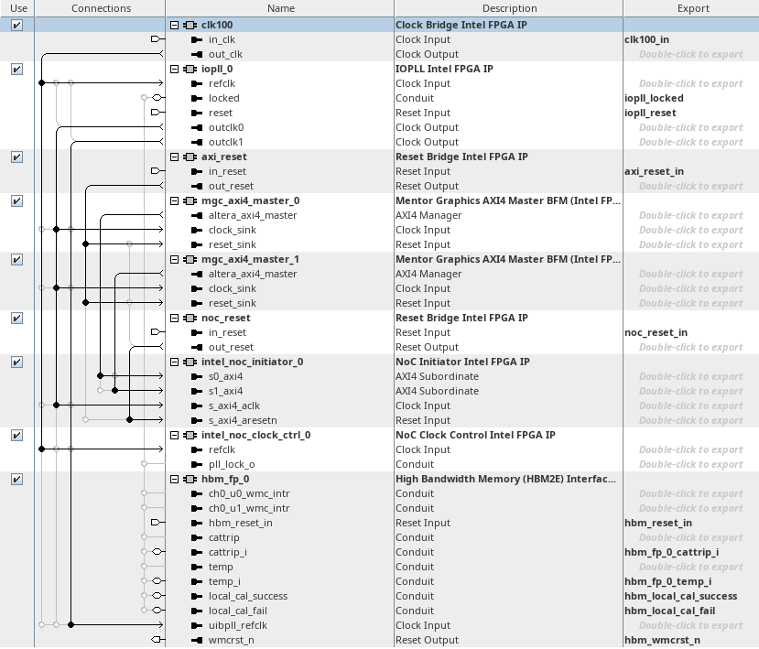
Platform Designer Simulation Design
Individual AXI BFM per channel
AXI BFM connected to NoC
NoC has no visible connections to the HBM

Slide 3
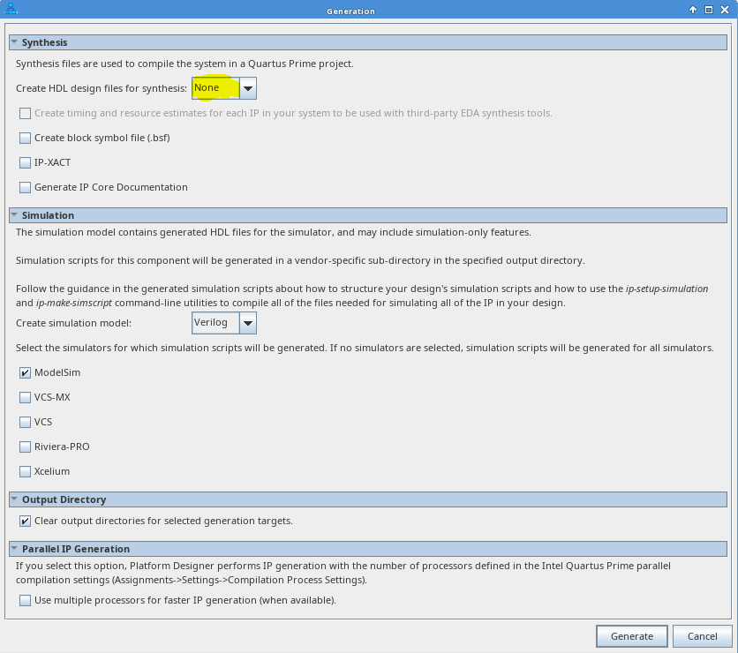
Simulation Model Generation
Must generate simulation model prior to running the simulation.
RTL Synthesis files cannot be generated.

Slide 4
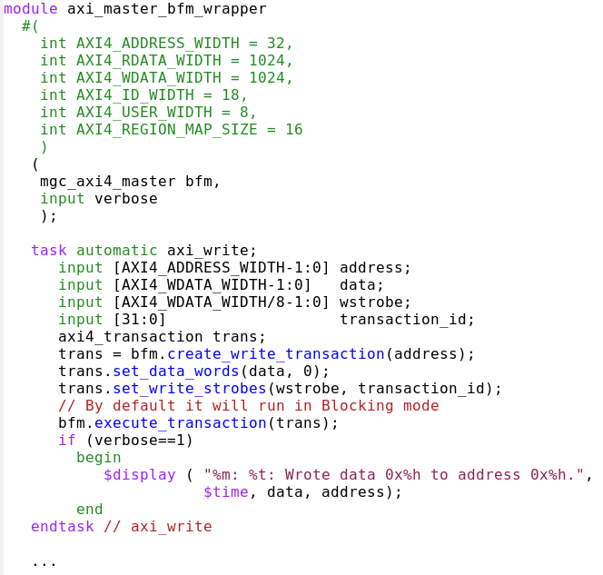
AXI BFM Wrapper Module
FILE: axi_master_bfm_wrapper.sv
axi_master_bfm_wrapper contains tasks for read and writes including bursts

Slide 5
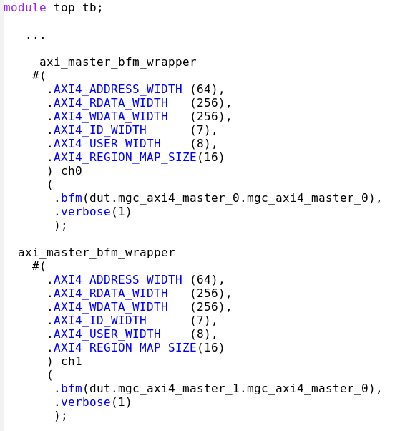
AXI BFM Wrapper Instances
FILE: top_tb.sv
An axi_master_bfm_wrapper module is instantiated for each BFM in the design.
The bfm port/interface allows for the connection between the axi_master_bfm_wrapper module and the AXI BFM instantiated in the design.
Instance names ch0 and ch1 are used here.

Slide 6
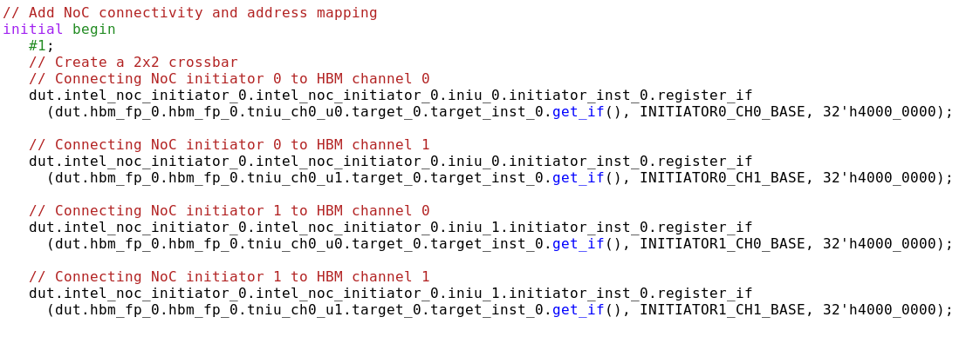
Noc Connectivity and Addressing
FILE: top_tb.sv
Define the NoC connectivity and address map within the testbench.

Slide 7
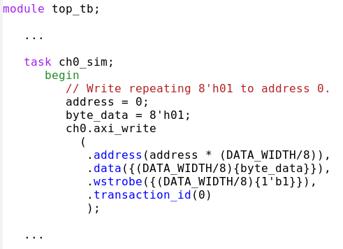
Top Level Task for Traffic Generation
FILE: top_tb.sv
Using the ch0 and ch1 instance names, tasks ch0_sim and ch1_sim are created to generate traffic.

Slide 8
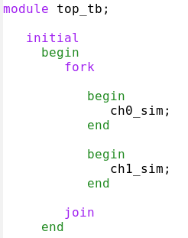
Task Run in Parallel
FILE: top_tb.sv
Each task is called within a fork-join block to allow for parallelism.

Slide 9
Running the Simulation on ARC
arc shell acds/23.4
arc shell questasim/2023.1,modelsim_se-lic/hdl
cd ./simulation
quartus_sh –t runme.tcl

Slide 10
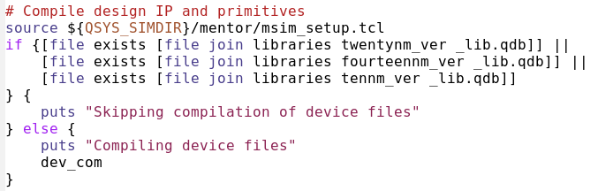
Simulation Speed Up
FILE: run_sim.tcl
Code attempts to skip dev_com if it has already been run.

Slide 11
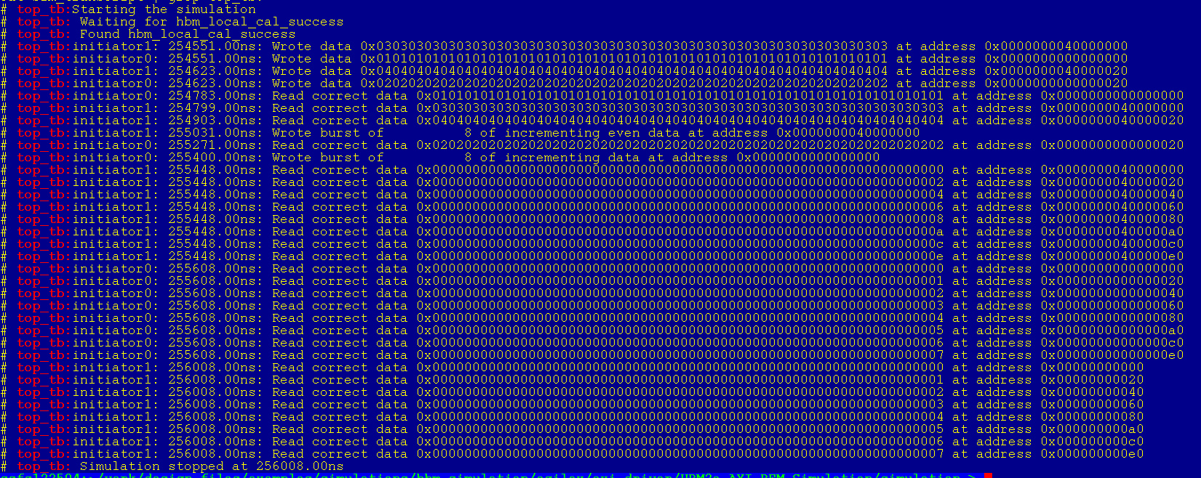
Simulation Results
%> cat transcript | grep top_tb:

Slide 12
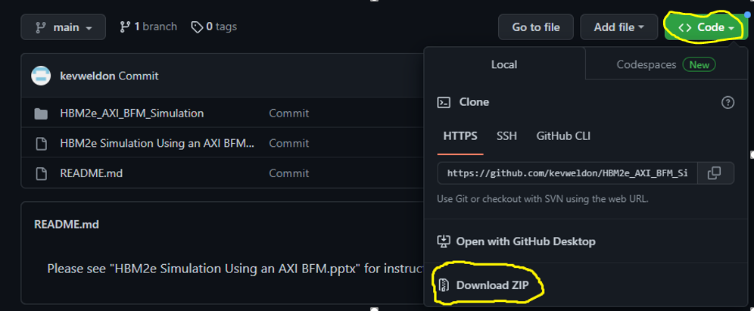
Simulation Example Location
Git code link: https://github.com/kevweldon/HBM2e_AXI_BFM_Simulation

Slide 13
Simulation Example Location
Git code link: https://github.com/kevweldon/HBM2e_AXI_BFM_Simulation
Git command line commands:
%> git init
%> git clone https://github.com/kevweldon/HBM2e_AXI_BFM_Simulation.git
May have to disconnect from VPN

